Slide 1
COVID-19 PREDICTION SYSTEM BASED ON SYMPTOMS
ECE 1901- TECHNICAL ANSWERS TO REAL WORLD PROBLEM
REVIEW -1 update

Slide 2
TEAM MEMBERS
U SAI PRANEETH -19BEC0005
RAVI YASWANTH SAI-19BEC0168
GAGAN KARTHIK K -19BEC0344
KESAV NAGENDRA -19BEC0378
KATTA JAYA KRISHNA -19BEC0382
SATYA SAI SUJAN N-19BEC0641

Slide 3
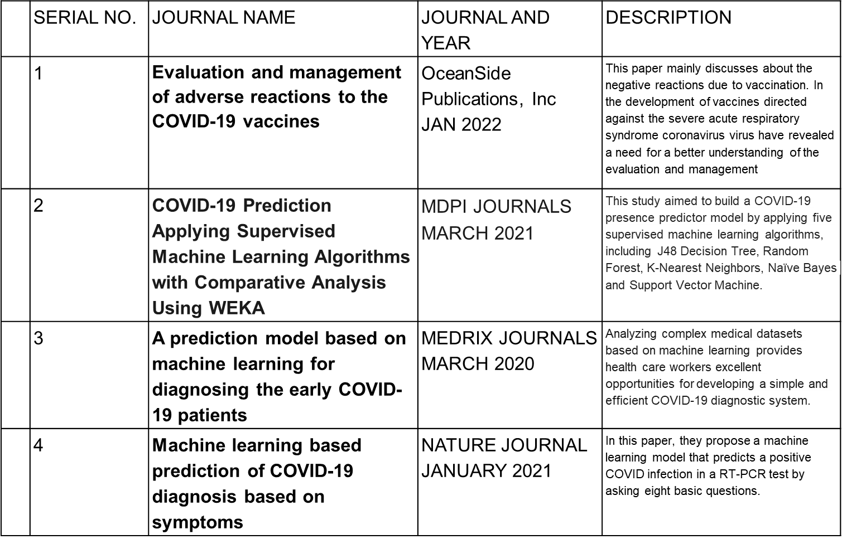
LITERATURE SURVEY

Slide 4
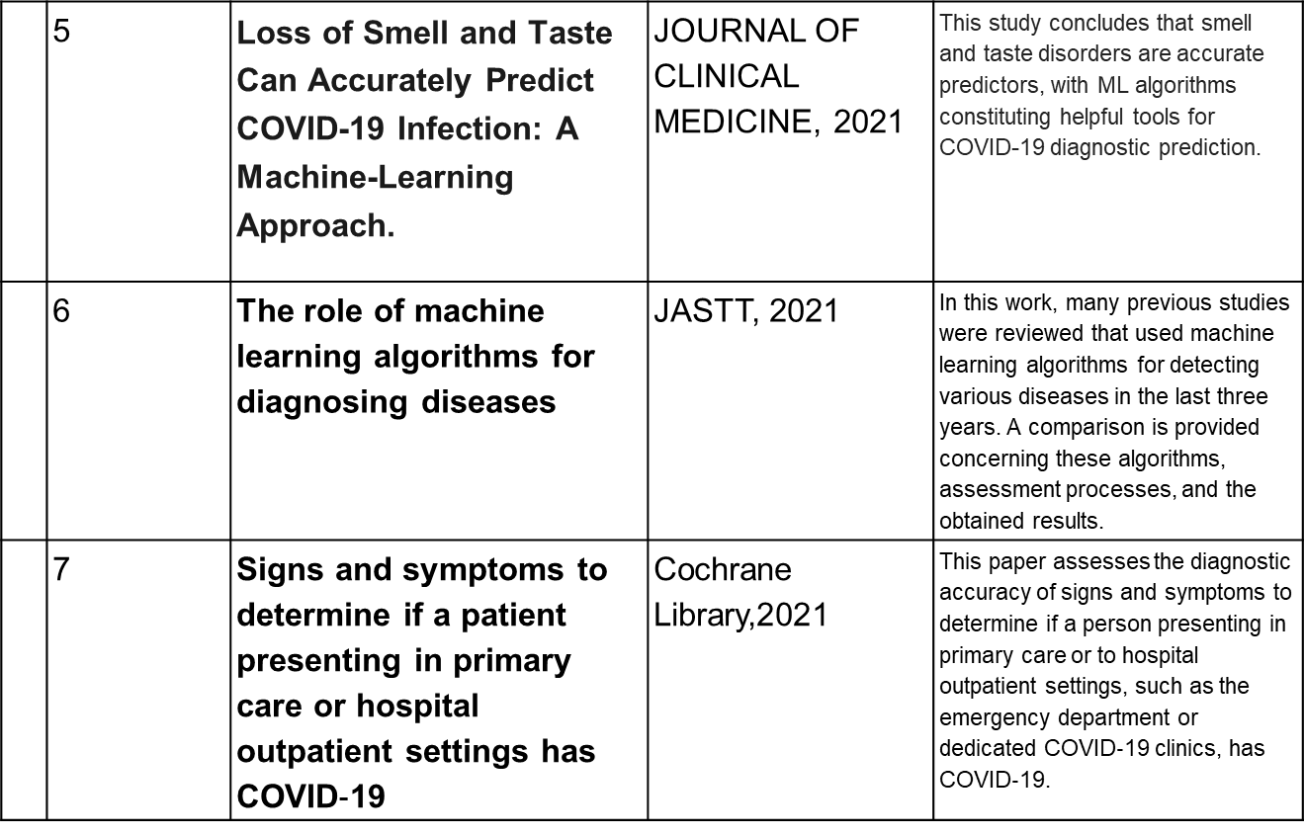
LITERATURE SURVEY

Slide 5
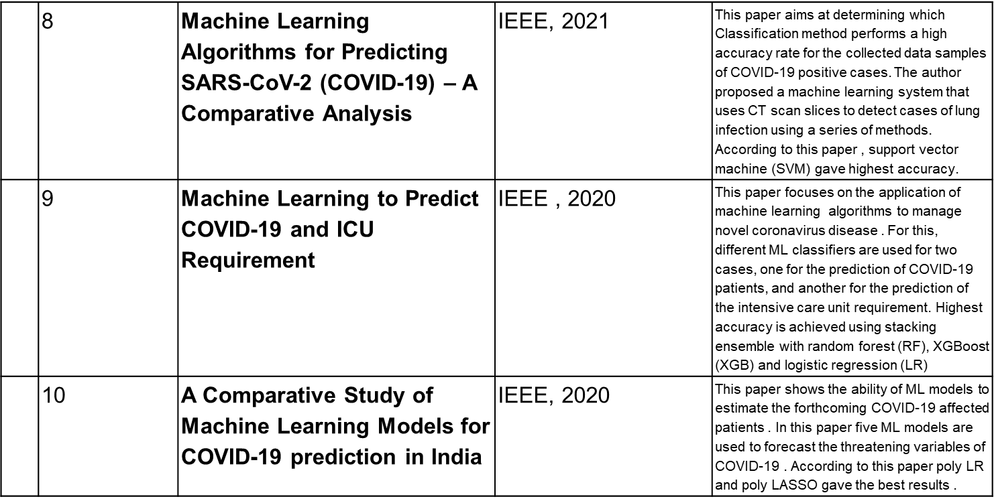
LITERATURE SURVEY

Slide 6
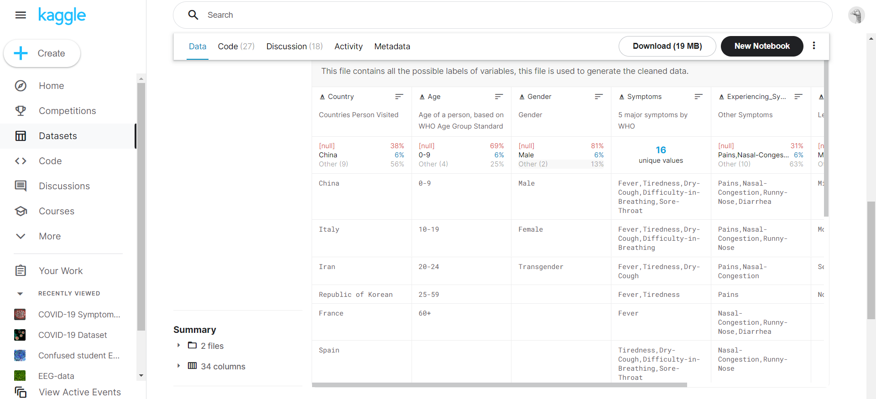
WORK PROGRESS
Data Collection : Kaggle

Slide 7
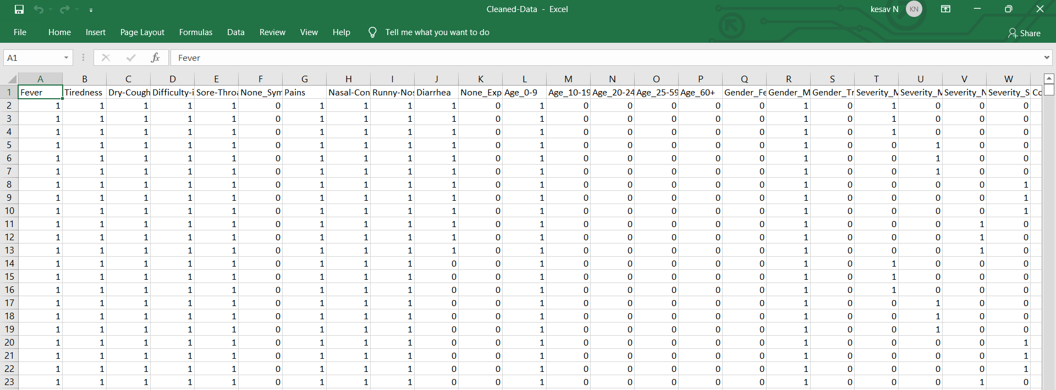
Work Process
Data preparation for machine learning model

Slide 8
WORK PROCESS
We are currently working on building machine learning models.
We are actually now building 2 models for prediction i.e Logistic regression, Random tree classifier.

